Slide 1


Patient, Carer and Public Involvement and Engagement in Anaesthesia Research
National Institute for Academic Anaesthesia
Health Services Research Centre
Patient, Carer & Public Involvement & Engagement in Research Group

Slide 2
Patient, Carer and Public Involvement and Engagement in Anaesthesia Research
This presentation will include:
Key definitions
The role of public involvement in anaesthesia research
How this is achieved

Slide 3
Definitions
Our research covers anaesthesia, perioperative medicine and pain management. This includes research into:
the care of patients of all ages undergoing anaesthesia for surgery, their preparation before surgery and recovery afterwards
pain relief after surgery or during childbirth
long-term pain conditions
Some examples of important research questions for us are:
What can we do to decrease major complications after surgery?
Are new technologies to treat chronic pain effective?
Can we improve the quality of care of patients undergoing emergency surgery?

Slide 4
Definitions
PCPIE – Patient, Carer and Public Involvement and Engagement in Research.
Research being carried out “with” or “by” members of the public, not trial participation.
Might include:
working with research funders to prioritise research topics
offering advice as members of a project steering group
commenting on and developing research materials
undertaking interviews with research participants
Notes:
May also be called PPI (Patient and Public Involvement)
Research being carried out “with” or “by” members of the public, rather than referring to people who participate in trials themselves

Slide 5
Roles for PCPIE in research
Indirect
Research prioritisation
Research policy/coordination
Direct
Co-investigators/study advisors
Peer review
Shaping research questions
Champion for participants
Developing patient-facing information
Engagement and dissemination of results

Slide 6
The importance of PCPIE in research
Broader picture – patients should be active partners in their healthcare, with more involvement in decisions over care and treatments.
Department of Health White Paper “Liberating the NHS” 2011 then consultation process 2012
Notes:
Some examples in peri-operative care:
Shared Decision Making used to explore options for surgical interventions
Enhanced Recovery Pathways, where patients are encouraged to be active partners in their recovery from surgery.

Slide 7

The importance of PCPIE in research
Patients are central to the aims of the National Institute for Health Research (NIHR):
To improve the health and wealth of the nation through research
To create a health research system in which the NHS supports outstanding individuals working in world-class facilities, conducting leading-edge research, focussed on the needs of patients and the public
Notes:
In line with this, patients are central to the work of the NHS “Research and Development” arm, the National Institute for Health Research (NIHR):

Slide 8
About the NIHR - background
Established 2006 in line with the new healthcare research strategy
Led by Dame Sally Davies
> £1 billion per year budget

Slide 9
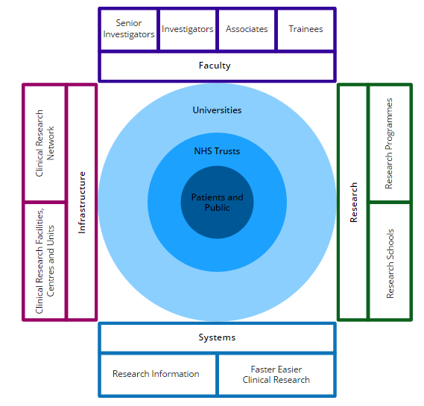
About the NIHR - roles
Grant giving programme (>£100 million)
Several funding “streams”
Infrastructure funding (>£150 million)
Networks (>£250 million)
Research career development
Portfolio of supported studies

Slide 10
PCPIE – benefits for patients & the public
Allows people to have a say in decisions about the way health research is planned, designed, delivered, developed, evaluated, managed and regulated.
Actively involves patients and the public in the conduct of research studies.
Helping set the research agenda and contributing to the conduct of research empowers patients, carers and the public - opportunity to positively influence their own and others’ health.

Slide 11
Positive impacts of PCPIE on research
More relevant research questions
Better study designs
Implementation and impact
Improved study delivery via NIHR clinical research networks
Notes:
Relevance of the research question
Asking patients what healthcare topic is important to them may lead to studies that are more meaningful to them, may enjoy better patient engagement and recruitment, and more interest in the results.
Study design
Getting participants’ perspectives of the study may improve the study design, for example by forming a better consent and recruitment process or more acceptable series of study visits for participants.
Implementation and impact
Stronger public and patient involvement throughout a piece of research may lead to wider dissemination of the results and greater impact through patient groups and charities.
Improving study delivery. The NIHR network involves PCPIE to assist study delivery in centres. Positive examples of its impact include:
A dialogue between the Respiratory Specialty and the Cystic Fibrosis Trust opened up new avenues for patients with Cystic Fibrosis to find out about relevant studies on the NIHR Portfolio.
The Hepatology specialty has reported that 30% of patients recruited into a genetics study first heard about the study via the PBC Foundation website and newsletter.
Regional patient and carer focus groups set up by local research networks helped to identify solutions to barriers faced during an Alzheimer’s disease study. Suggestions made by the focus groups, such as promoting the study more effectively in primary care, were implemented and a marked increase in recruitment was seen.

Slide 12
Positive impacts of PCPIE on research
Other benefits for researchers:
Demonstrates to funders that the topic is important and relevant to end users of research
Identifies areas that might have ethical considerations and can advise on solutions
Suggests ways that people can be meaningfully involved in the various stages of research
Can help with recruitment and informed consent
Notes:
Other benefits for researchers:
Demonstrates to funders and commissioners that the topic is important and relevant to end users of research and that they have been involved in the design of the research
Identifies areas that might have ethical considerations and can advise on solutions
Suggests ways that people can be meaningfully involved in the various stages of research
Can help with recruitment and informed consent
NOTE: there is increasing interest in assessing the impact of PCPIE on research projects more formally e.g. through the framework proposed by the PiAF group (Public Impact Assessment Framework)

Slide 13




Supporting PCPIE in Anaesthesia Research
PCPIE in Research Group
Priority Setting Partnerships
Research Design Services
CRN Anaesthesia Specialty Group PCPIE Strategy

Slide 14

About the NIAA and HSRC - Background
Review of Academic Anaesthesia 2005
Pandit RCoA 2005
Background:
1940s - 1970s
UK world leading research
Investigator led and initiated
Minimal bureaucracy
Core activity of consultants
1980s - 2010s
Universities & Research Assessment Exercise
Primacy of “basic science” research
Research governance
Job market

Slide 15
About the NIAA and HSRC - Background
Review of Academic Anaesthesia 2005
Pandit RCoA 2005
Review and consultation:
COMMENTS
No national profile
Fragmented
No strategy
RECOMMENDATIONS
Institute of Academic Anaesthesia
Academic departments
Proper focus of research
Academic training
Intercalated BS/PhD
Academic Foundation Year doctors
Research-active NHS consultants
Notes:
For this review the external advisors were:
Council of Heads of Medical Schools
Universities UK
Medical Research Council
Wellcome Trust
Department of Health

Slide 16

National Institute of Academic Anaesthesia (NIAA)
Established 2008
Vision:
Develop and maximise academic profile of Anaesthesia within the healthcare profession, NHS, Universities and major research bodies
Facilitate high profile, influential research
Facilitate and support training and continuing professional education in academia
Improve patient care by promoting the translation of research into clinical practice
Notes:
NIAA successes so far:
Engagement with NIHR and Department of Health:
NIHR Portfolio recognition for NIAA-funded studies
Identification of research priorities :
Prioritisation exercises: 1st round completed 2011, 2nd round underway
Grant awarding for partners:
£3.4 million (2008-13)

Slide 17
NIAA Health Services Research Centre (HSRC)
Launched 2011 as a resource to help the anaesthetic community improve our patients’ care
Health Services Research (HSR) is research with the aims of:
improving patient outcomes,
evaluating the delivery of healthcare.
Clinical epidemiology and clinical trials to demonstrate the effectiveness of interventions
“Glue” between clinical anaesthesia and the research agenda.
Filling “translation gaps”, for example between laboratory-based research and trials in humans
Notes:
HSR is research with the aim of improving patient outcomes (safety, effectiveness and experience), and evaluating the organisation, management, finances, and delivery of healthcare. It encompasses clinical epidemiology and clinical trials to demonstrate the effectiveness of interventions (phase III, health technology assessments)
“Glue” between clinical anaesthesia and the research agenda (audit and network of engaged clinical researchers)
Filling “translation gaps”, for example between laboratory-based research and trials in humans

Slide 18
NIAA / HSRC Patient, Carer and Public Involvement and Engagement Working Group
Development of NIAA and HSRC and their successful work with major funders brought an increased need for PCPIE within the specialty.
PCPIE Working Group established 2013.
Consists of:
Members of the Royal College of Anaesthetist’s Lay Committee with an interest in clinical research
Chair (Dr Mark Edwards, Southampton) and Deputy Chair (Dr Joyce Yeung, Birmingham)
Supported by the RCoA Clinical Quality & Research department

Slide 19
NIAA / HSRC Patient, Carer and Public Involvement and Engagement Working Group
Aims:
Provide patient and public involvement to support researchers in anaesthesia and perioperative medicine
To complement, but not replace local PCPIE input
Currently the focus is on providing input at the planning / design stage of research grant applications.
Further support may be offered depending on the research proposal and available resources
Provides a review of research proposals from the perspective of members of the public, including:
Overall perspective of the proposed research
Specific comments on lay summaries, patient-facing information and the likely participant experience in the proposed study

Slide 20
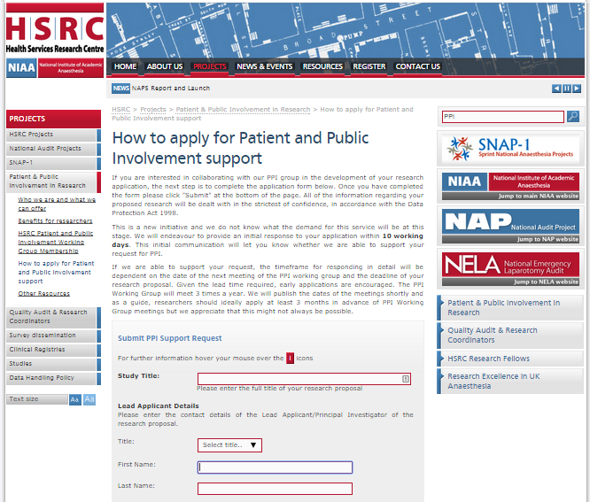
NIAA / HSRC Patient, Carer and Public Involvement and Engagement Working Group
Online support request
27 applications reviewed to date
Positive feedback from researchers on the Group’s input and support.
Several examples of research proposals being modified after PCPIE input.

Slide 21
Public involvement in Anaesthesia research priority setting
James Lind Alliance (JLA) Priority Setting Partnerships:
Brings patients, carers and clinicians together to identify and prioritise the top 10 uncertainties, about the effects of treatments that they agree are most important.
Work co-ordinated by the NIHR Evaluation, Trials and Studies Co-ordinating Centre
Notes:
Who is James Lind? 18th century naval surgeon – discovered cause of scurvy ?1st clinical trial

Slide 22
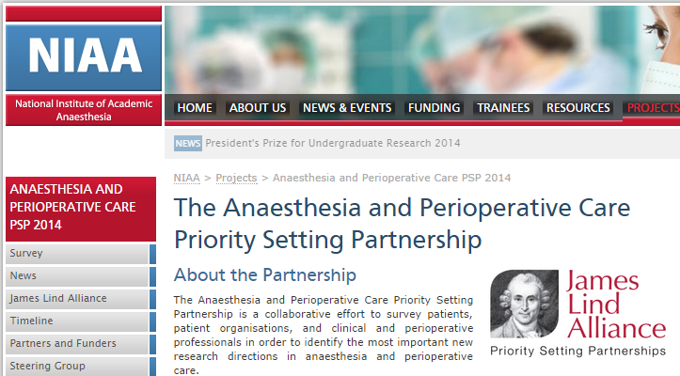
Public involvement in Anaesthesia research priority setting
First prioritisation exercise 2009 – 2011. Majority of priorities identified progressed to funded studies.
Second round (2014 – present) more focussed on public involvement through Partnership with JLA
Spring 2015 –Top 10 priorities finalised

Slide 23
Other ways of accessing PCPIE in Anaesthesia research
Sources of PCPIE for researchers:
Patients
Informal contacts
Institutional patient groups
Local NIHR Research Design Services (RDS)
Patient organisations and charities
Possible ways of engaging with public members:
face-to-face
online (e.g. www.peopleinresearch.org.uk)
social media (see http://www.invo.org.uk/wp-content/uploads/2014/11/9982-Social-Media-Guide-WEB.pdf for guidance)
Notes:
Note that engaging with patient groups may be challenging in anaesthesia / perioperative research – few chronic disease groups / core database

Slide 24
Conclusions
PCPIE is now a core part of research
It is a natural progression of patient partnership in healthcare
PCPIE may improve research quality
This is an evolving area; the resources to support PCPIE in Anaesthesia, Perioperative and Pain research are developing rapidly

Slide 25
Sources of useful information (1)
NIAA HSRC PCPIE Working Group
http://www.niaa-hsrc.org.uk/PPI#pt
INVOLVE
www.invo.org.uk INVOLVE is a national advisory group that supports PPI in NHS, public health and social care research. INVOLVE is funded by and part of the National Institute for Health Research (NIHR). The INVOLVE website has lots of useful information - for example there is a guide for researchers about PPI (http://www.invo.org.uk/resource-centre/resource-for-researchers/) and guidance on payments and expenses is updated regularly. There is also guidance on writing a plain English summary of your research proposal - seehttp://www.invo.org.uk/resource-centre/plain-english-summaries/ And you can sign up to receive a regular newsletter and obtain information about events.
The Public Involvement Impact Assessment Framework (PiiAF)
http://piiaf.org.uk/index.php PiiAF has been produced to help researchers assess the impacts of involving members of the public in their research in diverse fields from health care to local history.The PiiAF Study Group includes academics, public involvement facilitators from NIHR Research Networks and members of the public, supported by a grant from the UK Medical Research Council.
http://piiaf.org.uk/documents/exec-summary-0114.pdf - the gold standard on how to plan for and incorporate PPI in research. Not all of the recommendations would apply to every research proposal but it is a good place to start for guidance when considering PPI in your research.
You may also find the following links useful: http://piiaf.org.uk/resources.php - further PPI resources http://piiaf.org.uk/documents/tokenism-game.pdf - how to avoid 'tokenistic' approaches to PPI
People in Research
www.peopleinresearch.org People in Research connects members of the public to researchers who want to involve them in their work. You can use this website to advertise opportunities for involvement and for advice on how to recruit people to get actively involved in research.

Slide 26
Sources of useful information (2)
Plain English Campaign
www.plainenglish.co.uk The Plain English Campaign works to ensure that everyone has access to clear and concise information. They offer training, editing and a kitemarking system (the Crystal Mark). The Plain English Campaign website features a number of free brochures, including one on how to write in plain English (see www.plainenglish.co.uk/files/howto.pdf)
Research Design Service
http://www.nihr.ac.uk/Pages/researchdesignservice.aspx The NIHR Research Design Service (RDS) supports researchers to develop and design high quality research proposals for submission to NIHR and other national, peer-reviewed funding competitions for applied health or social care research. There are ten NIHR Research Design Services. All have a PPI lead who can offer advice about PPI at the design stage. Some also offer grants to enable researchers to develop PPI in research before they have obtained funding. Some have a PPI group - members may be able to offer 'public' input at the design stage of a study.
Healthcare Quality Improvement Partnership (HQIP)
http://www.hqip.org.uk/patient-and-public-involvement/ HQIP commissions reports into the standards of care for specific conditions and publishes the results, enabling healthcare staff to act upon them and provide better care for patients and service users. HQIP holds the contract to manage and develop the National Clinical Audit Programme, comprising more than 30 condition-specific clinical audits, and the contract to promote, develop and support clinical audit at local level on behalf of NHS England and the Welsh Government.
HQIP's PPI pages are designed both for patients looking to be more involved in clinical audits and for organisations looking to achieve effective PPI in their clinical audits.
Please see the specific patient and public information page for patients, service users, carers or members of the public wanting to learn more about clinical audits here:http://www.hqip.org.uk/patient-and-public-information/
http://www.hqip.org.uk/ppi-guidance/ - further useful PPI resources
The User Involvement in Voluntary Organisations Shared Learning Group
www.user-involvement.org.uk This group aims to encourage shared learning about service user and/or carer involvement between voluntary sector organisations working within the UK. It has a website with lots of useful information, including a section on involvement in research. If you are planning research involving people with a specific condition or experience you might find it helpful to contact the relevant member organisation.

